Slide 1


ECEN 404 Final Presentation Team 30: Smart Pest Repeller Andrew Albritton
Michael McNeil
Melquisedec Ordonez TA: Eric Robles Sponsor: Peng Hao Huang

Slide 2
Problem Overview
According to the ASPCA, of the 230,000 animals helped by their poison control center in 2019, about 10-15% suffered from issues related to pesticide exposure. Even with these downsides, pesticides are still the most used form of pest control because alternative methods such as ultrasonic (US) sound have shown to be much less effective.
The drawback to US is due to most devices on the market having a single programmed frequency output for sound. Since different pests will be deterred by different frequency outputs, while one type of pest may be deterred by the US device, other types of pest will remain.
Our solution to the problem with the efficacy of US devices is to design a US emitter system that uses a machine learning detection program to detect what type of pest is present, and then emit the frequency output that is effective for that pest type. This solution will be a much safer alternative to pesticides while also being much more effective than other US pest control devices on the market.

Slide 3
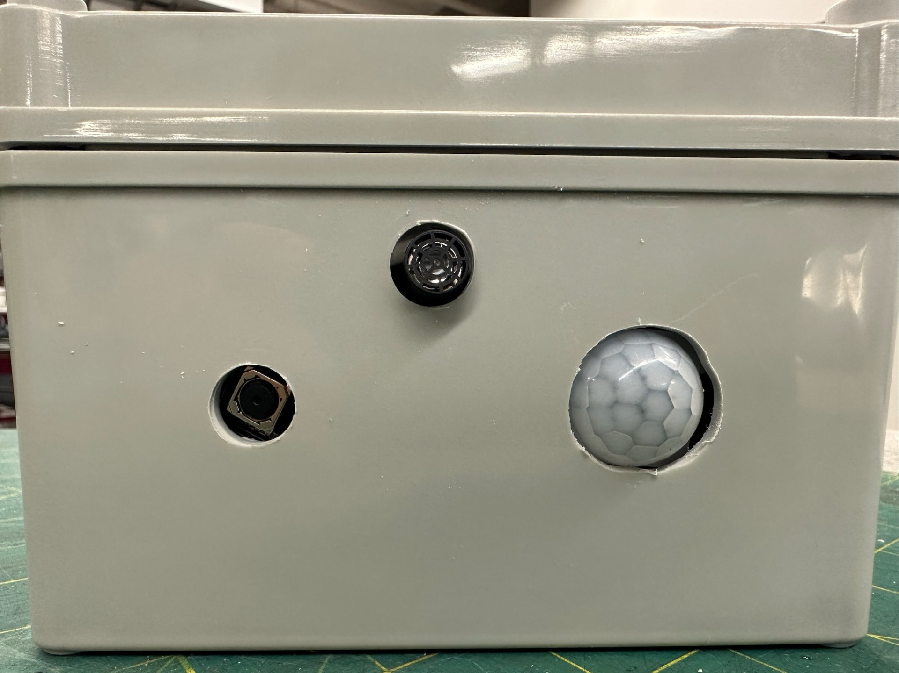
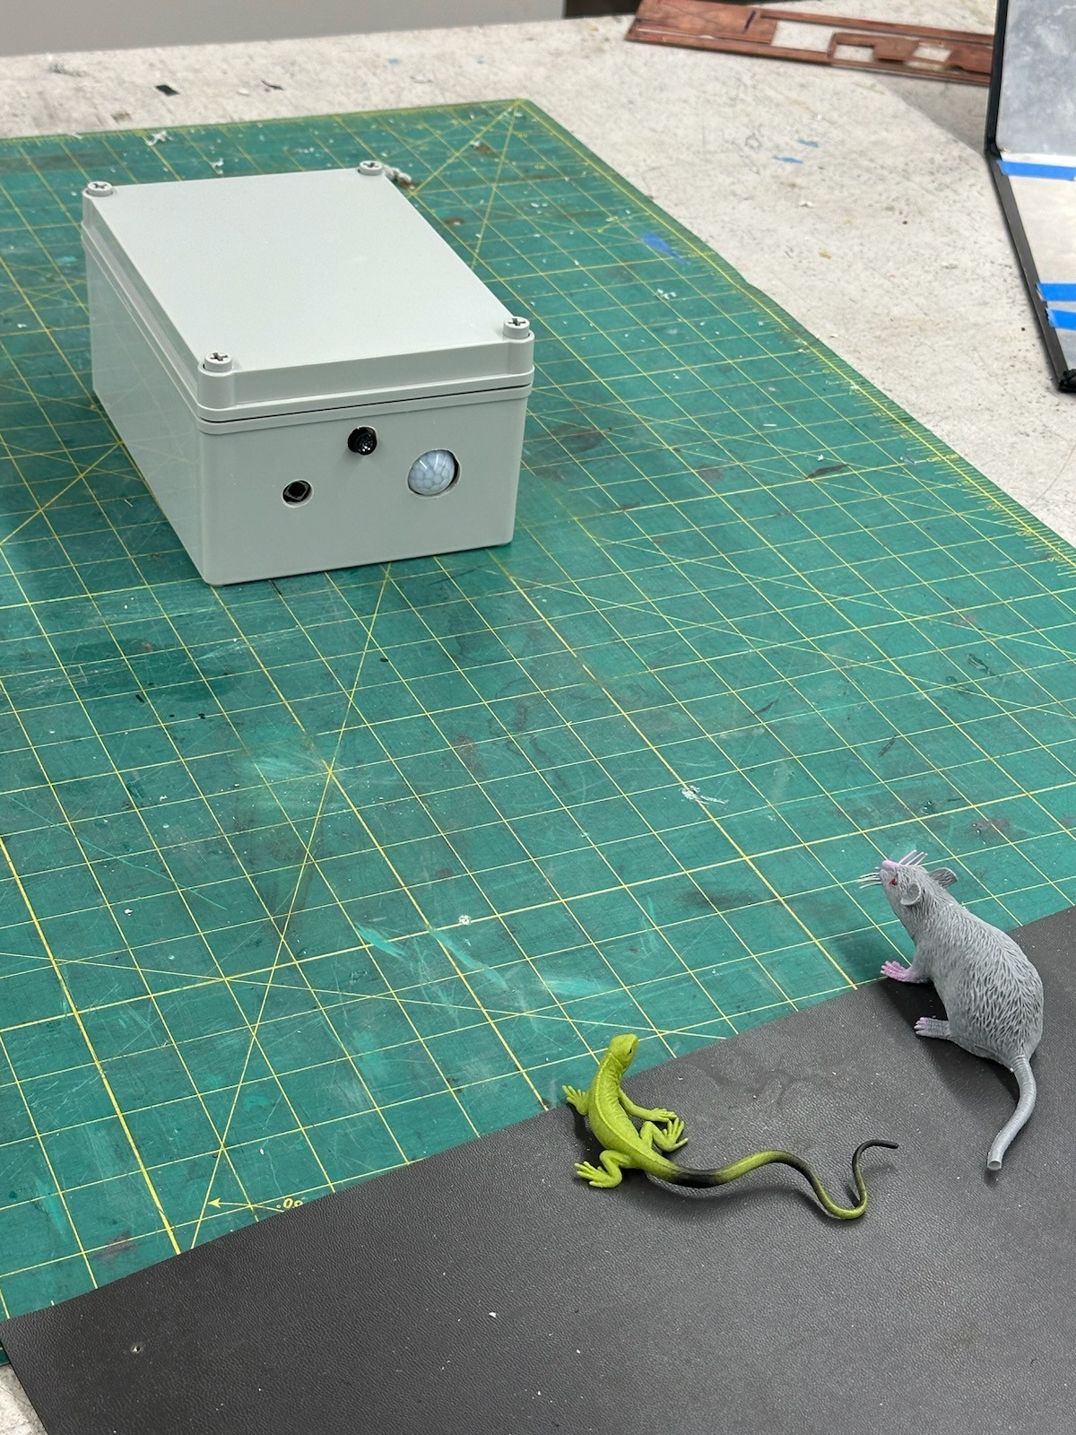
Integrated System
Only user interaction is the power switch found on the back of the system.
Wall power not being used in these photos.

Slide 4
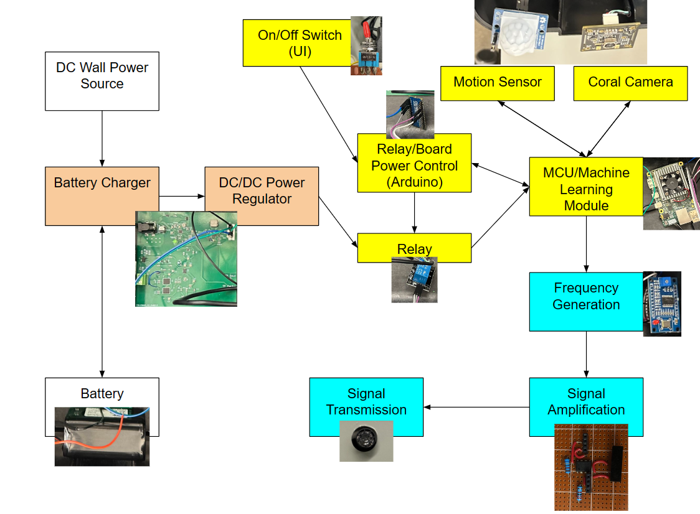
Integrated System Diagram
Michael - Orange / White Andrew - Yellow Mel - Blue

Slide 5
Power Subsystem
Overview:
Distributes power to detection subsystem MCU/sensors as well as emitter subsystem.
Operates from 7.2V 6.5Ah power source, able to be charged via 12V DC wall power source.
Challenges:
Fuel Gauge was originally planned to be implemented with I2C connections to track battery life and display to the user but due to issues connecting to the battery charger as well as time concerns it was scrapped in favor of sooner reaching integration and MVP status.
Battery Charger IC was changed from original 403 design to a newer IC with the same functionality but cheaper and easier implementation.

Slide 6
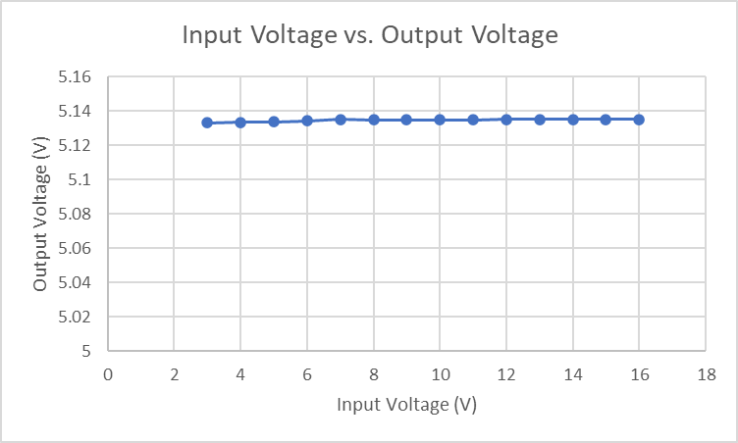
Power Subsystem
Michael McNeil
STAT Indicator | Charge Status
High | Charge Complete
Low | Charging
Done | Fault Detected
Fig. STAT Indicator Statuses
Fig. Input vs. Output Voltage Results
Specification | Min | Nominal | Max
Output DC Voltage | 4.5 | 5.0 | 5.2
Output DC Current | 1.0 | 2.0 | 2.2
Charger DC Voltage Output | 4.9 | 7.0 | 7.2
Charger DC Current Output | 1.8 | 2.0 | 2.2
Fig. Power Subsystem Specifications

Slide 7
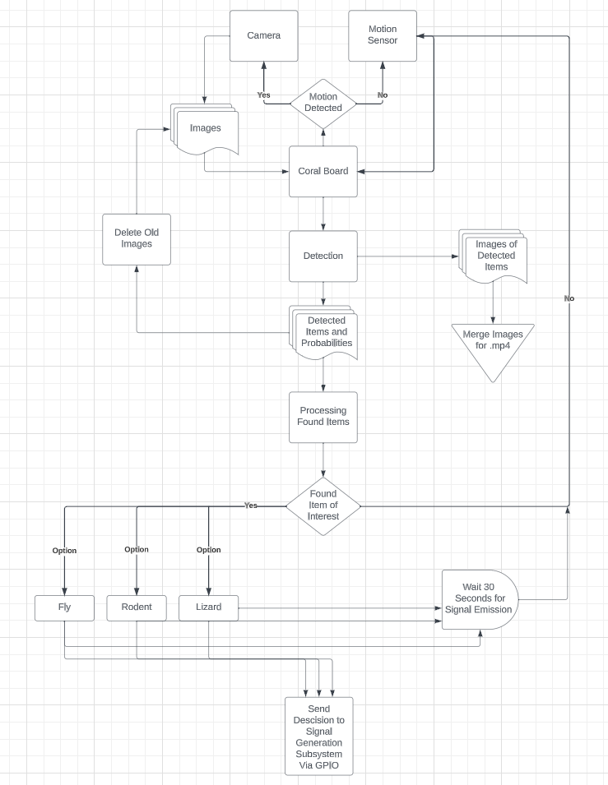
Machine Learning / Control Subsystem
Overview:
When the user powers the system, the ML program will immediately begin sensing for motion and processing images.
If either a rat, squirrel, lizard, or fly is present in the image, then a message via SPI will tell the emitter what frequency to send.
Challenges:
Shutdown procedure. Google requires the user shutdown the system through linux terminal.
Conversion of model/detection file from PyTorch to Tensorflow.
Run on boot setup. (temporary change to Jeston Nano)
Fig. ML Subsystem Block Diagram

Slide 8
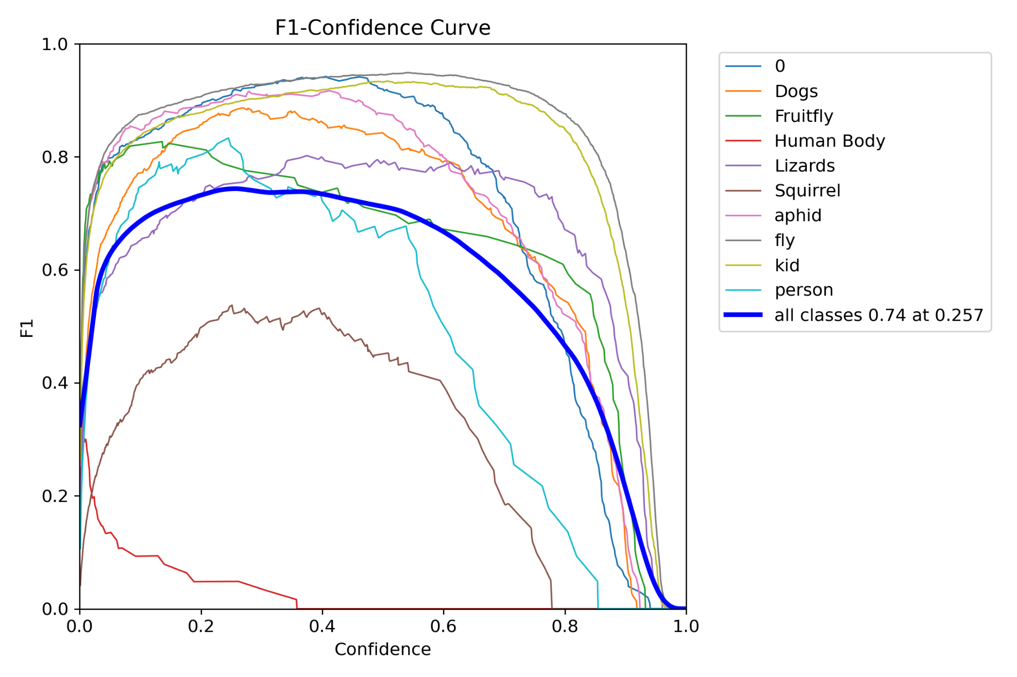
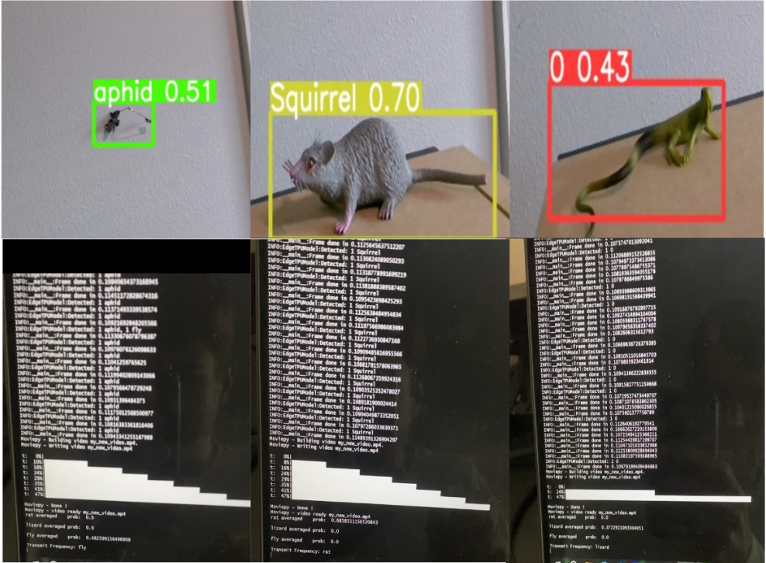
ML / Control Subsystem
Fig. ML Subsystem F1 Curve
Fig. ML Subsystem Detection Results
Specification
Processing Speed | 20 FPS | 50 Images | 2.5-3.5 Seconds
Detection Accuracy | Flies: 20-20 (100%) | Lizards: 18-20 (90%) | Rats: 16-20 (80%)
Minimum-Maximum Distance of Classification | Flies: min 3in max 2ft | Lizards: min 4in max 3.5ft | Rats: min 4in max 2.8ft
Power Switch | Coral Board turns off | Relay turns off after 10s delay | PASS
Fig. ML Subsystem Specs/Test Results

Slide 9
Emitter Subsystem
Overview:
Signal generator receives input from MCU telling it to generate signal at one of the three frequencies depending on which class was identified. Frequencies classes represent flies, lizards, and rats as they each are each repelled by different frequencies ranges.
Signal is then sent to amplifier before being sent to ultrasonic speaker as signal coming from generator is weak and the goal is to repel pest at a minimum of two feet.
Challenges:
Missed/Wrong connections on board lead to implementation of amplifier onto perfboard and emitter on seperate board due do time constraints
Impedance mismatch on ultrasonic emitter leading to lower lower gain from amplifier required a higher gain to compensate.

Slide 10
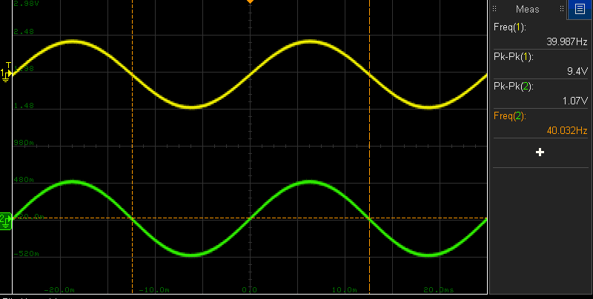
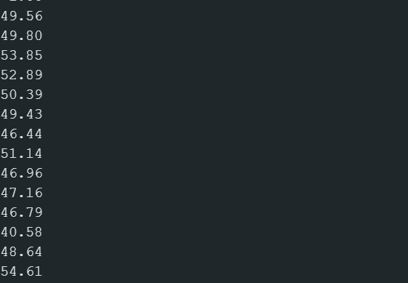
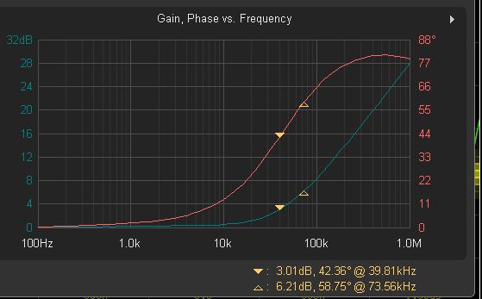
Emitter Subsystem
Figure 1: Amplifier Gain
Figure 2: Emission Distance in cm (Before Amplifier)
Specification | Expected | Tested
Range | 2 feet | 1 feet
Gain | 7V/V(~17dB) | 9V/V(~19dB)
SPL | 85dB at 30cm | -
Figure 3:Frequency Response After ~ 1Hr
Figure 4: Emitter Specifications

Slide 11
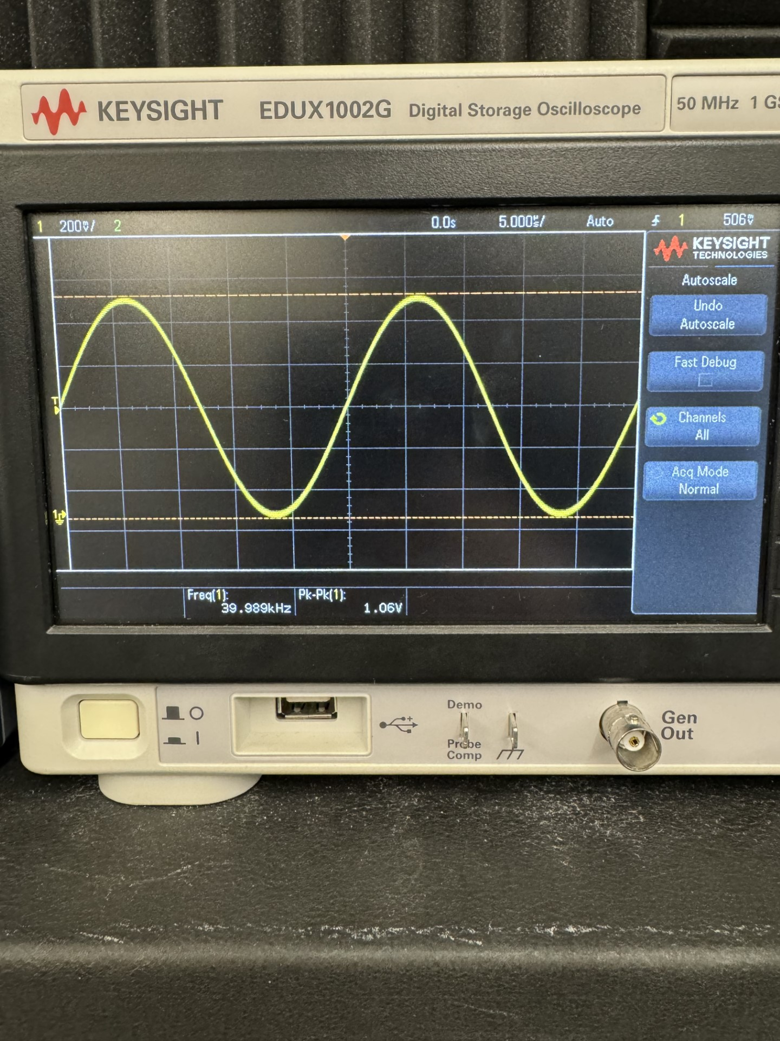
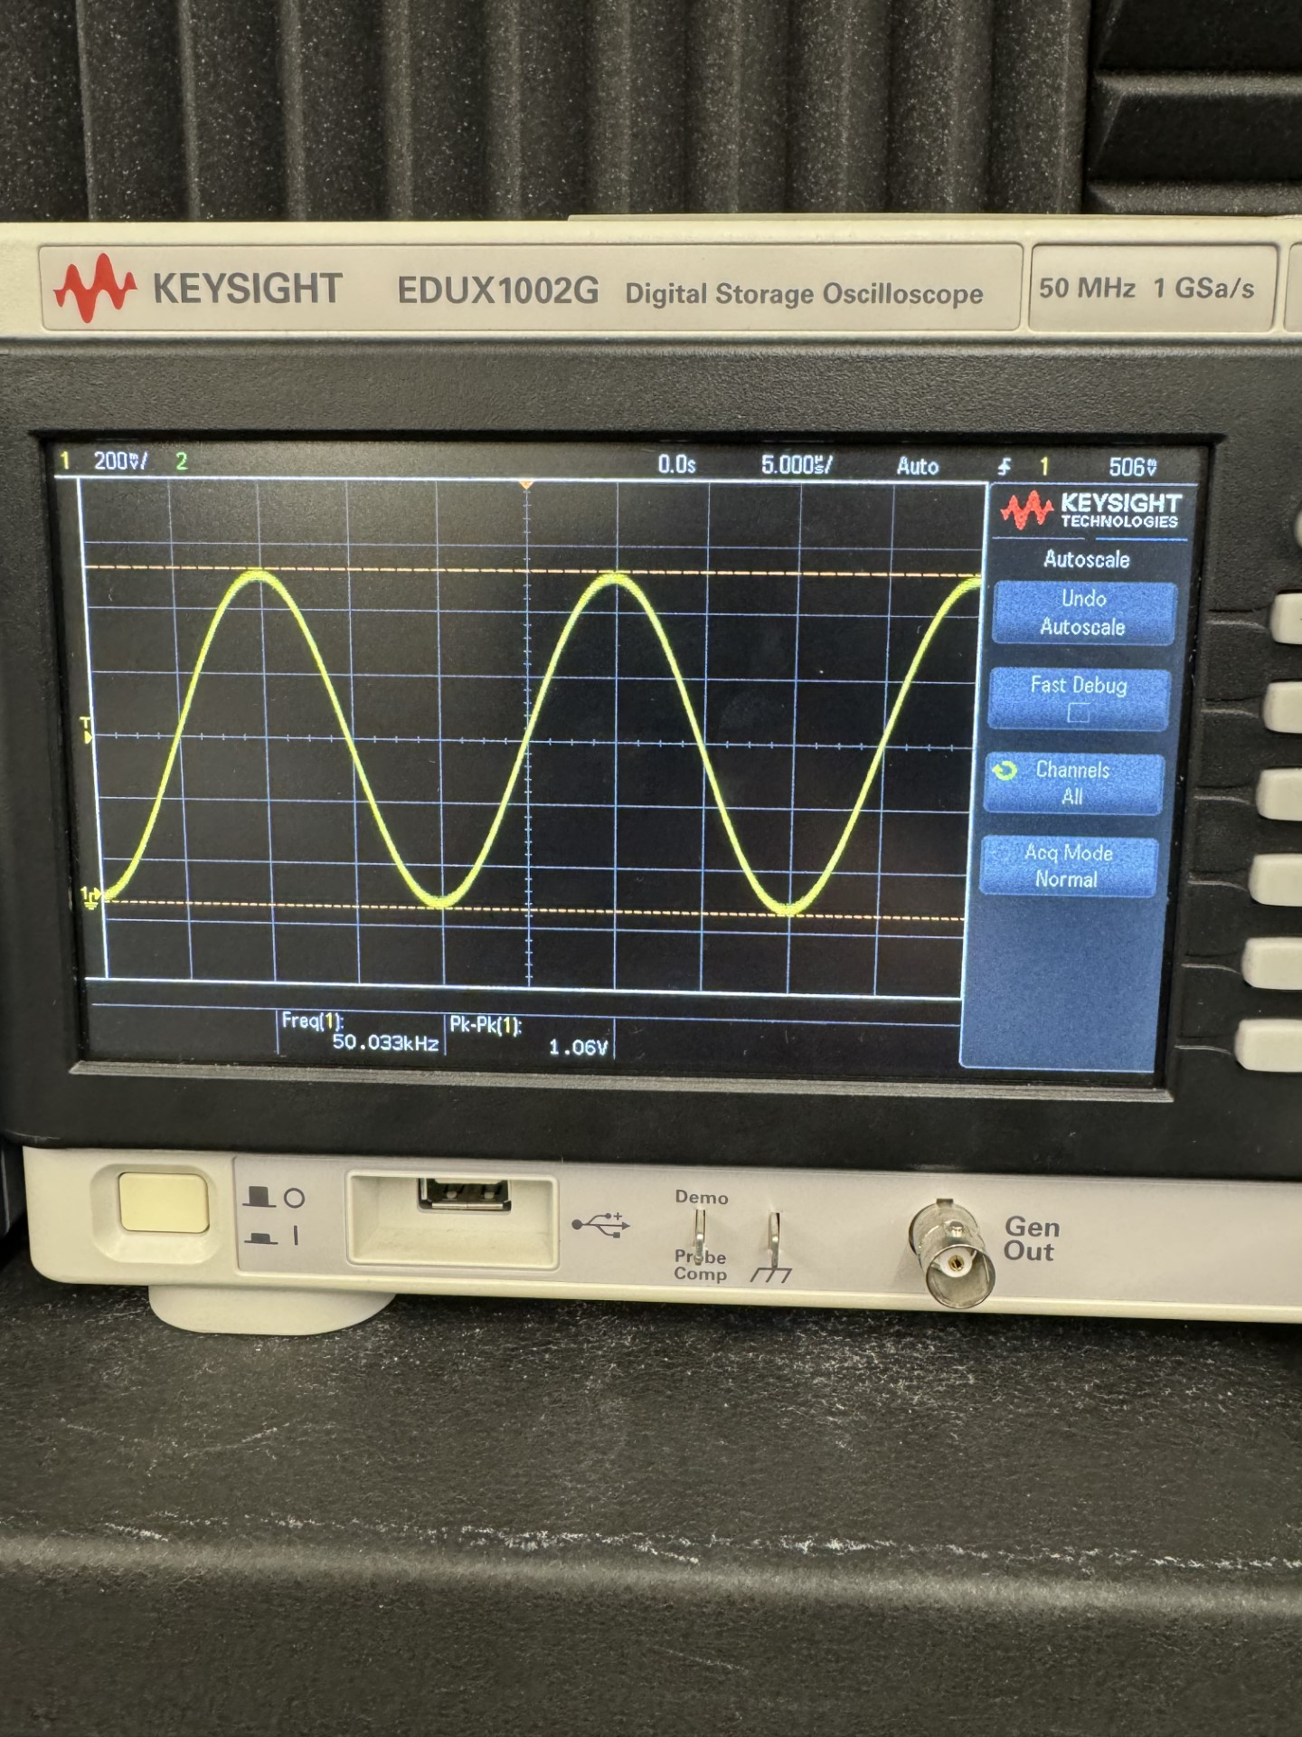
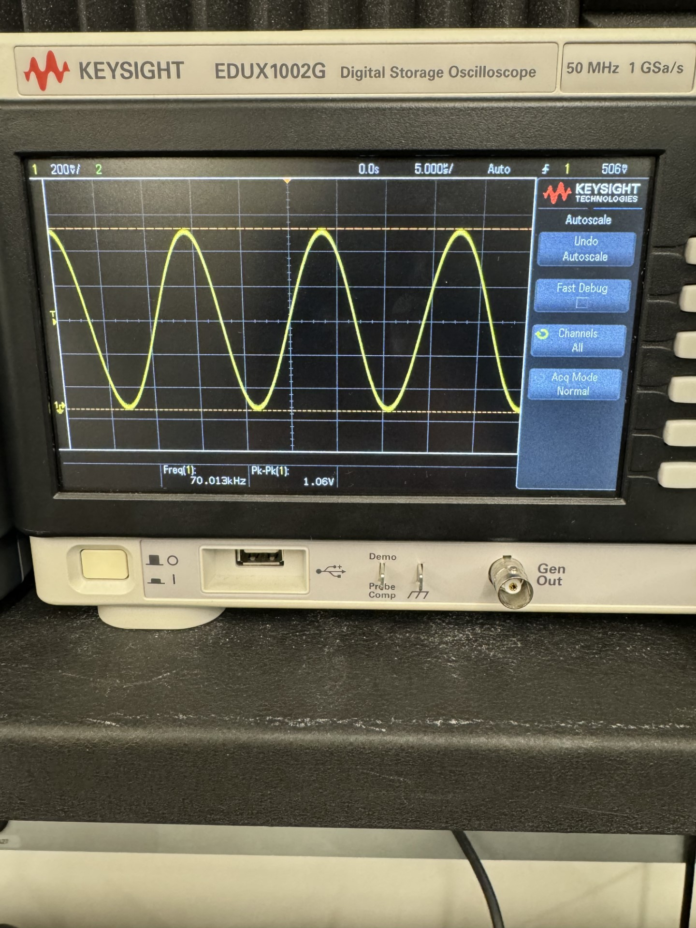
Integrated System Results
40 KHz (Deters Flies)
Tested with full integrated system except amplifier and transmitter.
(results to be gathered this week)
Total time between detected motion and emission ~5s.
Detection Accuracy shown in ML subsystem slide.
(subject to change when environment testing is complete)
50 KHz (Deters Lizards)
70 KHz (Deters Rats)

Slide 12
Conclusions
Issues:
Due to issues with GPIO capacity there was no space to implement a screen for UI.
I2C fuel gauge / Micro-Controller communication scrapped due to time concerns
Current Status:
Completed:
System is fully integrated
Subsystem validation (further validation on new perf board configuration is still needed for Relay/Signal Generation/Coral Board connections)
To Be Completed by Wednesday 4/17/2024:
Complete system placement in chassis.
Emitter strength vs. distance still to be tested.
Full system environment validation
Practice Demonstration

Slide 13
Thank You
Questions?

